Slide 1
The 2023 Kravitz Symposium October 13, 2023 Limitations and Consequences of the Use of AI
Joseph R. Carvalko Chair, Technology and Ethics Working Research Group Yale University Interdisciplinary Center for Bioethics

Slide 2
HOW MUCH OF THIS IS SCIENCE FICTION?
“… Science fiction is any idea that occurs in the head and doesn’t exist yet, but soon will, and will change everything for everybody, and nothing will ever be the same again. As soon as you have an idea that changes some small part of the world you are writing science fiction. It is always the art of the possible, never the impossible… If I’d lived in the late eighteen hundreds, I might have written a story predicting that strange vehicles would soon move across the landscape of the United States and would kill two million people in a period of seventy years. Science fiction is not just the art of the possible, but of the obvious. Once the automobile appeared you could have predicted that it would destroy as many people as it did.” -Ray Bradbury, in The Paris Review (2010).

Slide 3
Today’s Discussion
The fact is that AI has not suddenly descended upon the world or the legal profession.
The fact is that it’s impossible to predict what the next AI milestone will be, which when it arrives undoubtedly will have legal implications for the practice itself and as to how it affects our clients.
Discuss what issues to consider in evaluating the benefits of AI driven system today and foreseeing the legal, ethical issues that can arise.

Slide 4
EVIDENT PREMISES
Lawyers make critical decisions that have legally significant impacts on their client’s interest.
Thus, the AI delivery of legal services that rely on computer-generated content requires added due diligence to ensure the information and insights created are accurate and appropriate to the issue at hand.

Slide 5
PREDICTING THE DANGER POSED BY FUTURE AI TECHNOLOGIES
The technology’s (1) rate of diffusion (2) multiple products e g GPT is anticipated to augment, (3) dual use, and (4) depths to which it may penetrate daily life, including countless fields of employment.
Technology may face resistance or opposition from social and cultural forces that are not in favor of change. Technology may threaten the status quo, the traditions, or the identities of certain groups or individuals. Technology may also encounter barriers such as lack of awareness, education, trust, or acceptance among the public or the users.

Slide 6
PREDICTING THE DANGER POSED BY FUTURE AI TECHNOLOGIES
The uncertainty of future scenarios, e.g., Technology may interact with other factors, such as environmental, economic, political, or social changes, creating nonlinear and dynamic outcomes that are hard to predict.
Human cognition is subject to cognitive biases, heuristics, and fallacies that affect our perception, reasoning, and decision making. We may overestimate or underestimate the likelihood or severity of risks or ignore or dismiss them altogether.

Slide 7
AI IS NOT INTERESTED IN SECURITY
AI is vulnerable to the same hacks and attacks as other computing systems, and unexpected variations can render them ineffective, often granting security analysts a false sense of security.
1. Generative AI puts information into the public sphere, where it may expose confidential client or law firm propriety information.
2. In the wrong hands, information creates opportunistic ransom threats.
3. Wrong information exposes us to malpractice for unsupported legal advice or improper citations.

Slide 8
NEED TO BE PROACTIVE
Computer technology is complex, dynamic, and which we can only begin to understand if we enable ourselves to “see” its structure, content and processes as it penetrates the real world, and the legal domain. Two examples:
The technologies of AI, Internet of Things, Smart Devices, Big Data, Intelligent Information Systems, and Cloud Services are revolutionizing legal services throughout the world.
External data sources and sinks are inclusive of open-source intelligence, such as information available on the Internet and the dark web, and your firm’s internal proprietary information.

Slide 9
TREAT AI AS IF IT’S EXPERIMENTAL
We cannot be certain how AI technology will behave or evolve as it moves into the future, but we can create models and mock scenarios that test how it behaves.
We can only “see” if we employ resources with knowledge and skills to regularly audit and advise how we can minimize data breaches.

Slide 10
Technology may create new legal issues such as liability, accountability, or ownership.
Misfeasance-negligence for causing harm
Malfeasance-knowingly causing harm
Nonfeasance-intentional failure, refusal to fulfill obligation
Failure to anticipate alternate or dual use
Failure to consider effects of a combinational integration
Failure to consider black swan events, civil unrest, nature disasters

Slide 11
WARNINGS
Currently generative AI is prone to generate false information, hallucinate reporting something that is not actually present.
Use generative AI to structure and not generate content. For example, you can ask ChatGPT to give you an outline for a contract or complaint, but you can’t ask it to write either for you.
AI may be a legal research assistant but not your supervisor. Check how your assistant did and not simply take what they did and put it into your advice letter, contract or complaint.

Slide 12
WARNINGS
ChatGPT may provide general information about the law, such as definitions, facts, or examples, but cannot guarantee the accuracy, quality, or legality of such content and itself claims it cannot apply the law to specific situations or cases.
ChatGPT users should also respect the laws and regulations of their jurisdiction regarding the UPL and avoid any activities that may violate them.

Slide 13
MORE SPECIFICALLY:
Intellectual Property Infringement: Generative AI has the capability to create content that may infringe upon existing copyrights, trademarks, or patents. If the AI generates content that copies or closely resembles someone else's protected work, there could be legal consequences.
Unfair Competition: Generative AI might create content that mimics or imitates existing products or services, potentially leading to unfair competition claims if it causes confusion among consumers or dilutes the reputation of existing brands.

Slide 14
MORE SPECIFICALLY
Defamation and Misinformation: If generative AI produces content that spreads false information or defamatory statements about individuals or organizations, it could potentially lead to legal issues related to defamation, libel, or slander.
Privacy: Generative AI is privacy-adverse, as it has as its objective satisfying the query, notwithstanding any privacy implication.
Ethical Concerns: While not strictly legal liabilities, generative AI raises ethical questions, such as the potential for bias, discrimination, or manipulation. Addressing these concerns may become necessary to avoid reputational and legal risks.

Slide 15
UNAUTHORIZED PRACTICE OF LAW
Generative AI has the potential to increase the risk of unauthorized practice of law (UPL) if it provides legal advice or engages in activities that are deemed to be the practice of law without the necessary authorization. While generative AI can assist in generating legal documents or providing general legal information, it should not be considered a substitute for the expertise and professional judgment of a licensed attorney. However, note that generative AI itself does not practice law it assists lawyers in generating content or identifying potential legal issues.

Slide 16
AN ACT CONCERNING ARTIFICIAL INTELLIGENCE, AUTOMATED DECISION-MAKING AND PERSONAL DATA PRIVACY.
January Session, 2023 Substitute Senate Bill No. 1103
SUMMARY This bill requires the executive and judicial branches to (1) conduct an inventory of all their systems that employ artificial intelligence (AI) and (2) develop and set policies and procedures on developing, procuring, using, and assessing systems that use AI. It also requires them to publicly post the inventory and policies and procedures online.
Beginning February 1, 2024, the bill prohibits the executive and judicial branches from implementing any system that uses AI unless they have done an impact assessment to ensure the system will not result in any unlawful discrimination or disparate impact against specified individuals or groups (e.g., age and race). It also establishes a 21-member working group to make recommendations to the General Law Committee on certain issues concerning AI.

Slide 17
…the bill establishes the Connecticut Artificial
Intelligence Advisory Board in the legislative branch to hold public
hearings on the draft procedures and advise state agencies on AI and
automated system policies. It also establishes a task force to study AI
and develop and make recommendations on adoption of an AI bill of
Rights.

Slide 18
In 2014, Chief Justice John Roberts, in a 9-0 opinion ruled that police officers may not, without a warrant, search digital information on a cell phone data seized from an individual who has been arrested, stating that “modern cell phones . . . are now such a pervasive and insistent part of daily life that the proverbial visitor from Mars might conclude they were an important feature of human anatomy.” Riley v. California, 573 U. S. ____ (2014).

Slide 19
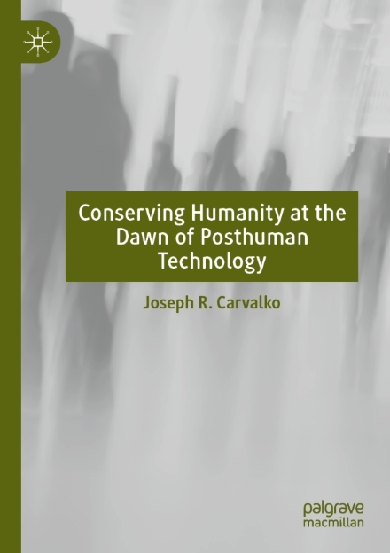

Slide 20
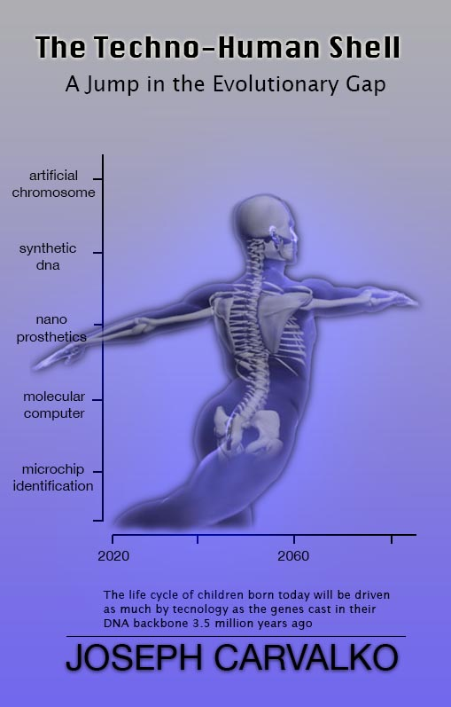

Slide 21
THANK YOU

